Slide 1
Serialization an overview
Brand Protection Through
Serialization and Authentication
Presented by
Alastair Taylor
Regional Sales Manager
May 24th 2016

Slide 2
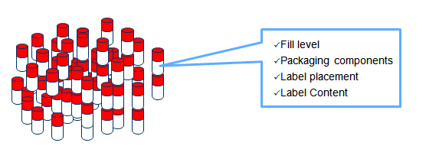
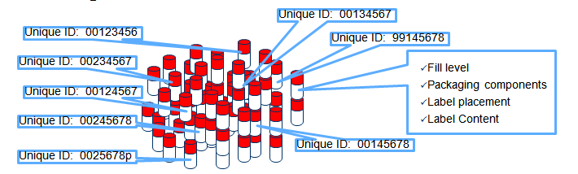
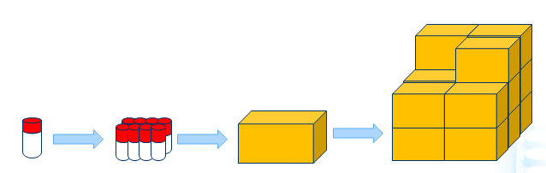
SERIALIZED PRODUCT TRACKING
Classic Mindset
  Produce a large number of identical units
With Serialization
  Uniquely identify each unit
  Associate items to their parents
© 2015 Systech International. V1.2

Slide 3









SERIALIZATION TRACK & TRACE REQUIREMENTS
United States
Manufacturers
Jan ’15 – Lot-Level traceabilility and verification of lot info
Nov ’17 – Unit Serialization - unit and homogenous case
2023 – Track & Trace
European Union
Unit Serialization
Q1 ’19
Pharmacy Verification
Ukraine
Unit Serialization
Jul ’15 – Expecting 2-yr delay
Argentina
Unit Serialization
Jan ’12 – 1st phase products
Jan ’13 – Additional products
Jul ‘13 – Additional products
Jan ‘14 – Additional products
Jul ‘14 – Additional products
ANMAT System with aggregation for high-volume products
Brazil
Track & Trace
Traceability – buyer/seller
Dec ‘13 – Resolution No. RDC-54
Dec ‘15 – 1st of 3 batches due
Dec ’16 – All products/batches due
Algeria
Unit Serialization
Jan ’14 – Expecting 2-3-yr delay

Slide 4


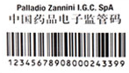




SERIALIZATION TRACK & TRACE REQUIREMENTS
Turkey
Track & Trace
Jul ’10 – Serialized DataMatrix
Jan ‘12 – Traceability – MoH system
China
Track & Trace (code 128c)
’11, ’12, & ’13 – In effect for EDL
’15 – In effect for all drugs
CFDA System
Mandatory unit/case aggregation
Veterinary Products (QR-Code)
’15 – Vaccines
’16 – All veterinary Products
Jordan
Unit Serialization
Jan ’17
South Korea
Jan ’13 – Lot-level DataMatrix
Jan ’15 – 30% Serialized DataMatrix
Jan ’16 – All Products Serialized DataMatrix and Track & Trace Likely
India
Unit- and case-level serialization
Exports and government sales
‘13-’15 – Systems pending
Saudi Arabia
Mar ’15 – Lot-level DataMatrix
Mar ‘17 – Serialized DataMatrix
TBD – Track & Trace pending

Slide 5



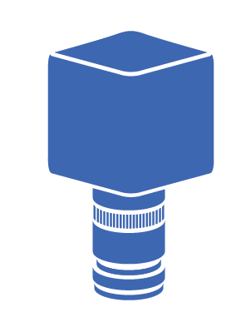
SOLUTION
LEVEL 5 | AUTHENTICATION
Implement a serialization solution that:
Provides serial number range management
Serial number validation
Meets regulatory compliance
Can be upgraded and re-configured
Integrates with existing or new hardware
Deploys rapidly and scales with the business
Adapts to packaging and regulatory changes
Remotely supportable without having to wait for an engineer to arrive
LEVEL 4 | ENTERPRISE
LEVEL 3 | SITE
LEVEL 2 | LINE
LEVEL 1 | DEVICE
LEVEL 0 | VERIFIED

Slide 6
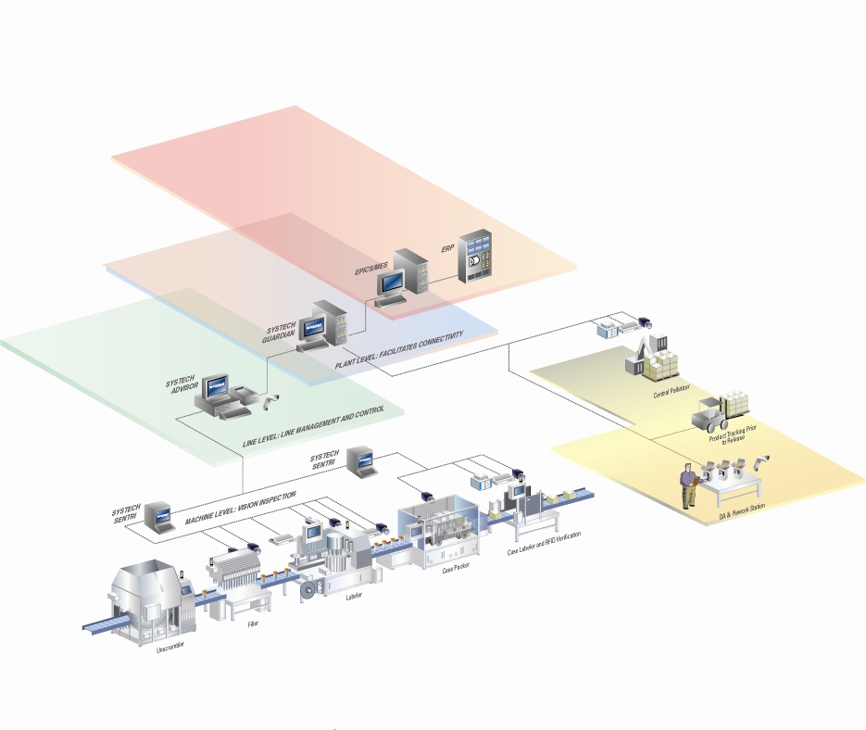
Serialization Architecture

Slide 7
CHALLENGES OF MULTI-VENDOR MODEL
Only One truly integrated platform
LEVEL 5 | AUTHENTICATION CLOUD
SUPPLY CHAIN
VENDOR 4
  Eliminates hidden costs
    All vendors have to be brought back in when changes have to be made to the line
  Removes potential for data mismanagement
    Multi-vendor = multiple failure points in architecture
  Increase accountability
    Single point of accountability for the total solution
LEVEL 4 | ENTERPRISE
VENDOR 3
LEVEL 3 | SITE
VENDOR 2
LEVEL 2 | LINE
VENDOR 1
LEVEL 1 | DEVICE
LEVEL 0 |
PARTNER EQUIPMENT
SYSTECH CERTIFIED
Notes:
RAPID DEPLOYMENT :
(more slines, maximize performance, constant upgrades)
Across all packaging operations – palletizing, post lot rework, QA release, shipping,
Only one to provide an end-to-end platform. Fully integrated.

Slide 8

SYSTECH END-TO-END SERIALIZATION
ENTERPRISE-WIDE TRACEABILITY
ECONOMIES OF SCALE
REDUCED DATA CORRUPTION
FLEXIBLE LINE IMPLEMENTATIONS
COMPLIANCE REPORTING
REGULATORY & PARTNER INTEGRATION
LEVEL 5 | AUTHENTICATION
LEVEL 4 | ENTERPRISE
LEVEL 3 | SITE
LEVEL 2 | LINE
LEVEL 1 | DEVICE
LEVEL 0 | POWERED BY SYSTECH
Notes:
POWERED BY SYSTECH – MACHINES POWERED BY SYSTECH

Slide 9
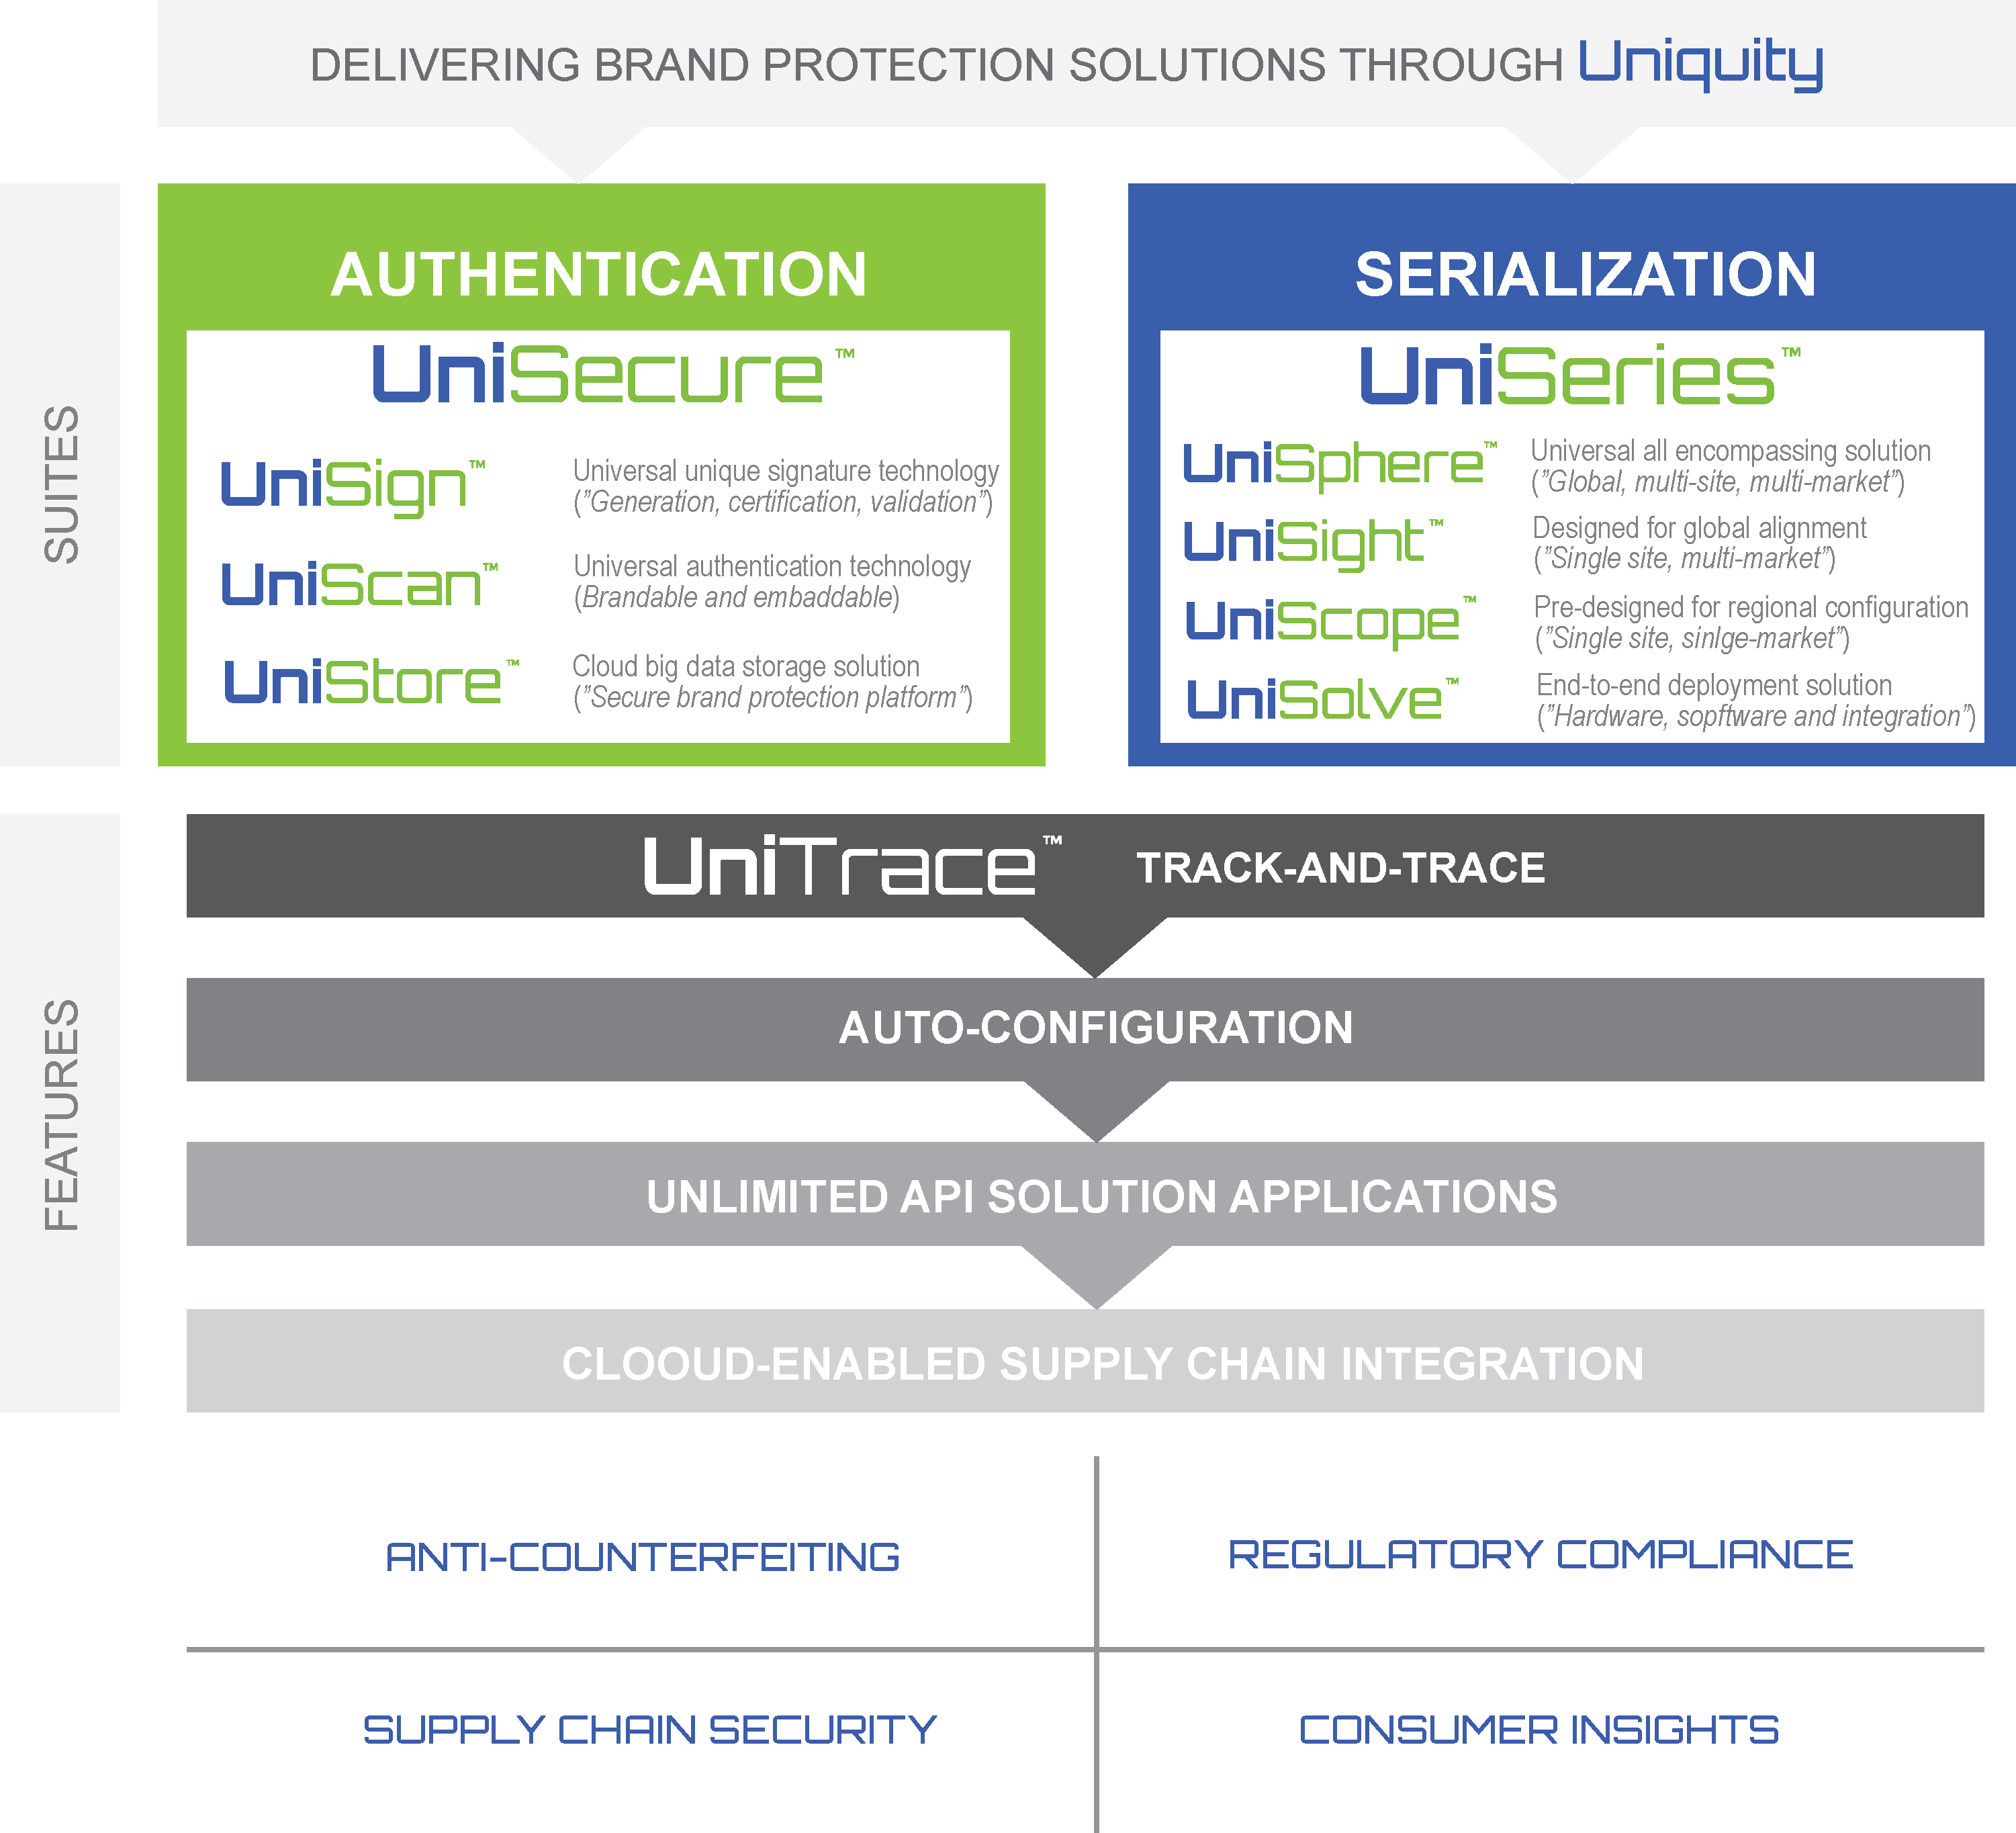
SOLUTION PLATFORM

Slide 10
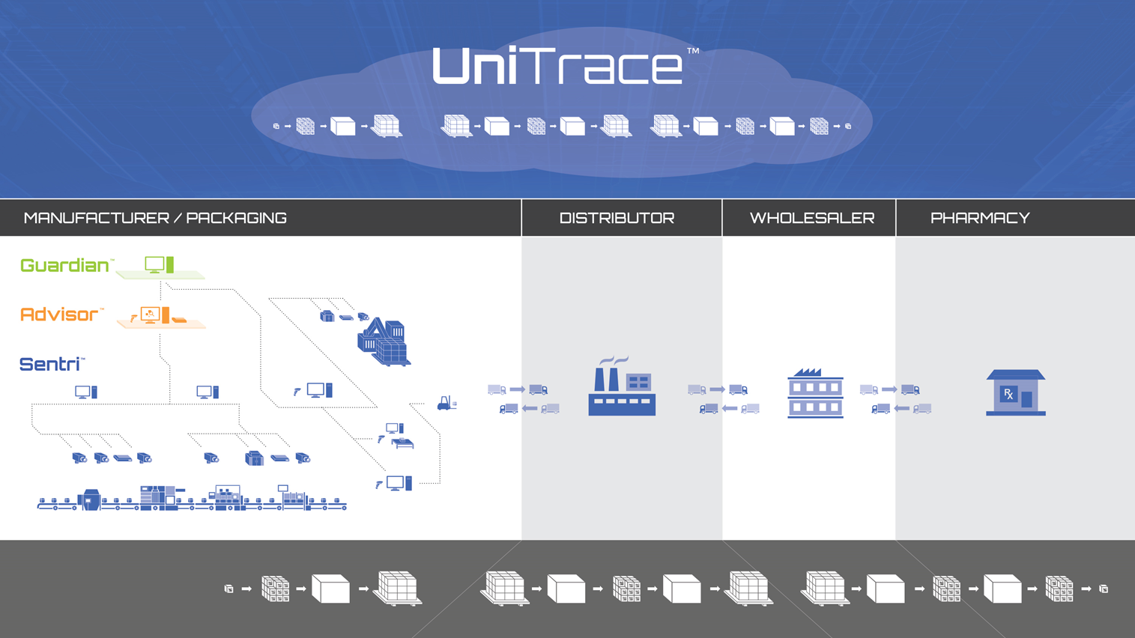

Slide 11

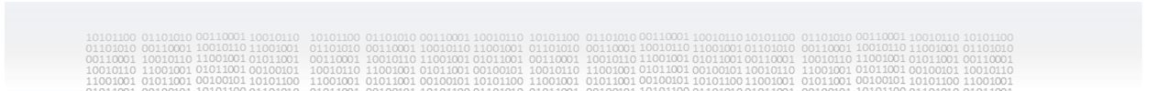

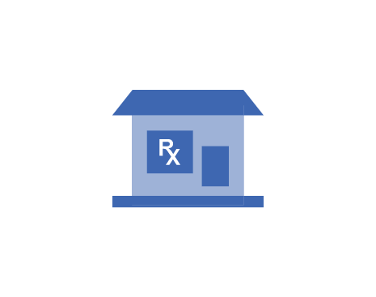




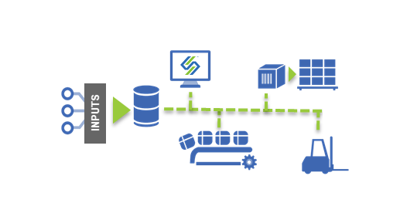


Level 4 UniTrace
Serialization
Data exchange
Serial number generation & management
Third parties & Multiple suppliers
EPCIS repository
Track & Trace
Validate source content at production
Visibility and reporting of supply chain movement
Exception handling support
Manufacturing / Packaging
Distributor
Wholesaler
Pharmacy

Slide 12
UNISERIES - PRODUCT FEATURES & BENEFITS
Only One Serialization Platform
Complete data management (end-end stack, one s/w platform/one set of interfaces)
Cross functional packaging capabilities (off-line, on-line, QA post lot etc..)
Over 200+ Standardized use cases
Regional and global options
KEY BENEFITS
Ensures data integrity and license to operate
Supports complete packing integration
Reduced TCO, minimized down-time
Rapid deployment & flexibility
Ability for in depth supply chain insight
Operational dashboards, analytics, an actionable intelligence

Slide 13
PROVEN MODEL
Rapid Deployment
Reduces risk
Delivered standardized, tested solutions
Standardized Configurations
Over 200 Standard use case templates
Speed implementation, reduce risk, avoids mistakes, pitfalls, and protect investment
Flexibile Design
Patented configuration software
Reduces change costs
Minimizes downtime
Protects your investment
Adaptable
Meets packaging and regulatory needs
Add new regulations – Drop into existing deployed solutions
Infinitely Scalable
Supports any regional regulation or brand initiative with no customization
Notes:
UniSeries reduces risk and delivers rapid deployments through solution standardization

Slide 14
GUARDIAN SITE SOFTWARE (Level 3)
Supports centralized Master Data and Batch Work Order processing to the lines.
Self-sufficient in regards to managing Line-level serialization packaging processes without the need of an EPCIS environment.
Provides a gateway between the Level 4 EPCIS layer and the packaging line, ensuring day-to-day production needs are met.
Provides the fundamental architecture to meet post packaging operations, such as; centralized pallet building, post lot rework, and re-packaging of commissioned product to meet distribution shipment needs.
Data and number management with multiple high-speed packaging lines, regardless of client’s Level 4 EPCIS integration needs.
Site-level reporting on packaging and serialization metrics.

Slide 15

THE SYSTECH LEVEL 3 DIFFERENCE
Enterprise/Cloud Level
Site-Level Management Console
  Centralized user administration
  Sophisticated collection/analysis of data
  Master Data / Batch Work Order support
  Central Pallet, Post Lot Rework, QA and Shipping Support
Single access point and data exchange hub
  Management of data flows in both directions
  Reduce impact on corporate repository
Bridge between corporate LAN and manufacturing network
  Supports stand-alone operations if communication to L4 fails
  Ensures data integrity throughout all levels
Complies with ISA 95 solution stack and ISA 99 network security requirements
Built in Sand-box environment that allows simulation of entire serialization process
Site Level
Line Level
Device Level

Slide 16
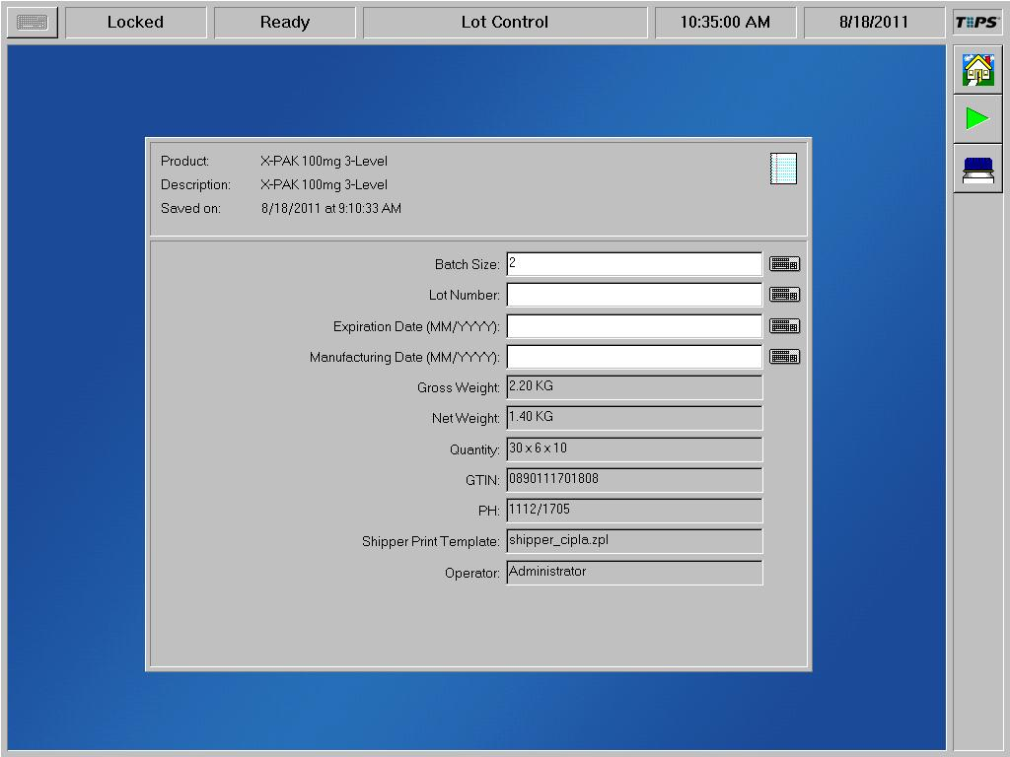
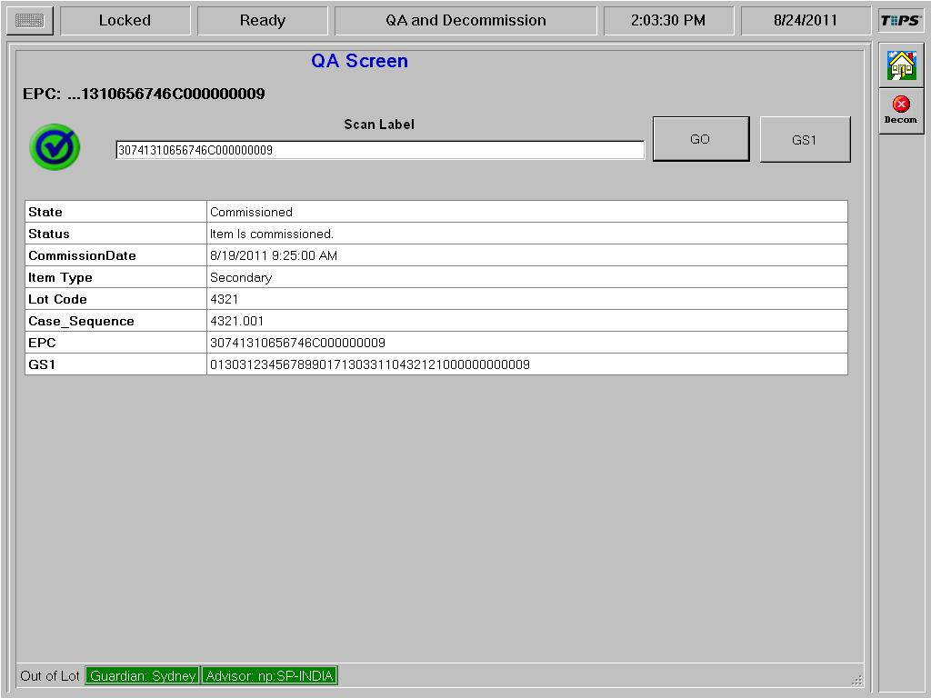
ADVISOR LINE SOFTWARE (Level 2)
Line Management Features including
  Line Performance Metrics, Lot Reporting, Alarms Management
  Procedural Controls and Device Interfaces
Tight productized interoperability with Sentri Device Software
  Integration of Device-level communication with Site-level operations provides automated decommissioning for failed inspections.
ES Workflow Management
  Control and maintain item level and parent to child relationships, while associating and storing each serial number along the way.
  Patented IPS logic for configuring and controlling workflows
  Full in-lot rework and QA process support
Tight productized interoperability with Guardian Site Software
  Reduced risk integration between different vendors
  Optimized communication keeps packaging lines running

Slide 17
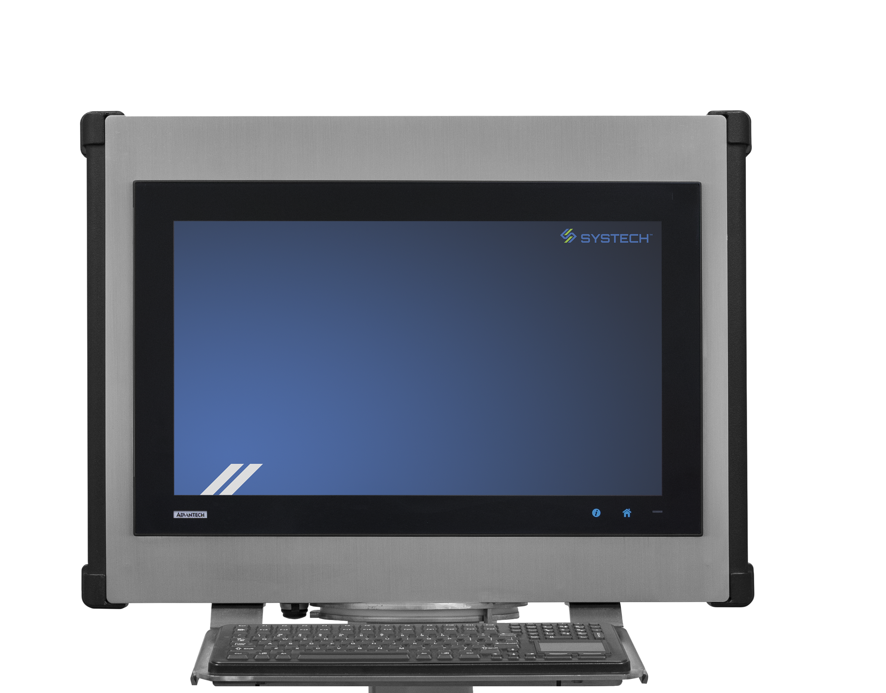
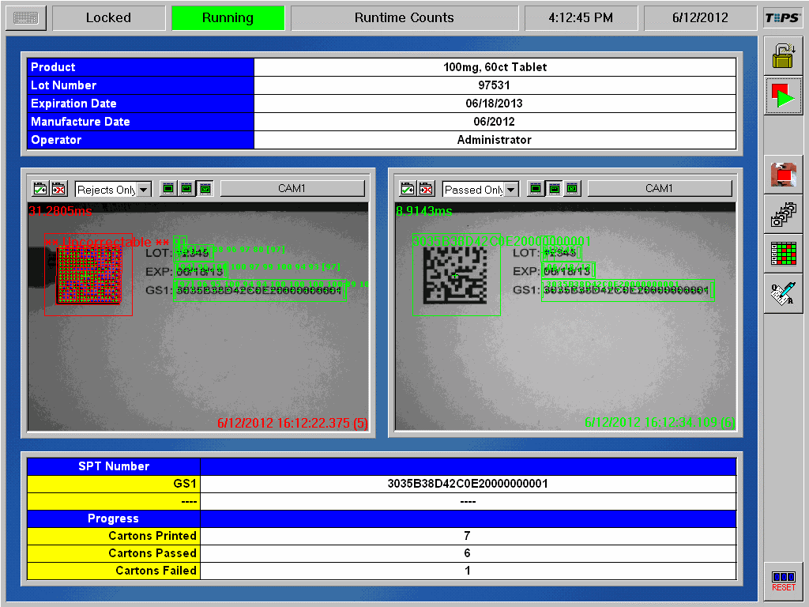
SENTRI HARDWARE AND DEVICE SOFTWARE (Level 1)
High-Speed inspection processing with complete suite of vision tools for pharmaceutical packaging
  Data Matrix Scoring mapped to ISO/IEC 15415 and trainable on-line
  OCV, OCR, linear and 2D barcodes, print quality and other tools
  User-Friendly Statistical Training Process
  Advanced Pack-By-Layer solution for automatic and manual case aggregation
Tight productized interoperability with Advisor Line Software
  Reduced risk integration between different vendors
  User Access control to vision functions and Vision Run Mode status display from a single user interface
  View multiple vision inspections from a single interface
  Single point for user access control and security integrated with Active Directory.
  Single point setup of all vision inspections from Line-level at the start of the Lot

Slide 18
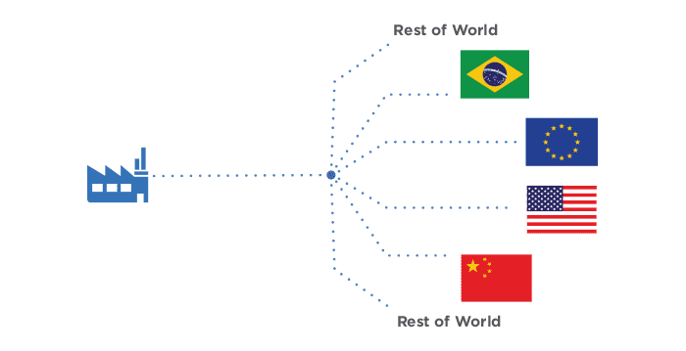

UNISIGHT – MULTIPLE REGION SOLUTION
Supports multiple regions from a single manufacturing line
Benefits
Meets regional regulatory requirements around the globe
Rapid implementation
Reduce line downtime
Easily add site level
Future proofed compliance
Features
Built-in test and simulation environment
Supports in-lot and post-lot rework operations
Customized to specific packaging use cases
Centralized palletizing
Packaging use cases, pack-by-layer, centralized palletizing
Master data and package order support
Non-serialized quality vision inspection
Suspend and resume lot selections
Reporting
Advanced configuration options

Slide 19
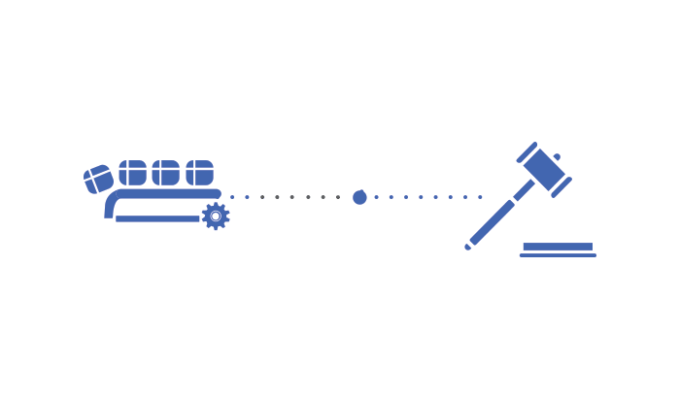

UNISCOPE – REGIONAL COMPLIANCE SOLUTION
One line support for One regional compliance
Benefits
Rapid implementation to reduce line downtime
Complete site, line and device level support
Efficient design and configuration
Future proofed compliance
Regional support for US, EU, Brazil, China and others
Upgradeable within Systech’s UniSeries
Features
Meets regional regulatory requirements
Supports in-lot and post-lot rework operations
Customized to specific packaging use cases
Master data and package order support
Built-in test and simulation environment
Non-serialized quality vision inspection
Suspend and resume lot selections
Reporting

Slide 20








UniSolve – ‘Turnkey’
  One Partner responsible for
  Standard catalogue offerings
  Total project management
  Delivering machines
    Survey, select, order, build, start-up, ship
    Complete documentation
  Expert site services
    Line start-up, SAT, IQOQ support
  Post implementation support
    Take the calls
    Partner escalation channels
    Faster delivery minimizing line downtime
  Pre-engineered packaging stations
  Pre-defined workflows
  Regional installation services network

Slide 21
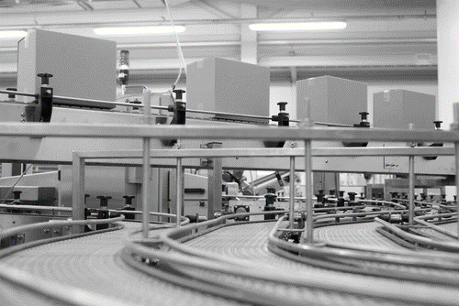
UNDERSTAND, IDENTIFY, PRIORITIZE AND DEPLOY
How ?
Identify compliance requirements
Asses impacts to your business and systems
Build a plan and identify gaps
Prioritize sites and lines
Understand your supply chain
Collaborate with trading partners
Start Now!!!
“..a scalable proven serialization solution that enables us to meet the changing marketing requirements and
effectively respond to global security challenges”
Ian Haynes, Principal Pharmaceutical Engineer
AstraZeneca

Slide 22
WHERE DO WE START?
When planning for a new deployment, several high level questions need to be asked beyond the mechanical operation of the packaging equipment and what levels require serialization
  Which products?
  Which markets? Which Regulations?
  Which Production Lines?
  How long will the line(s) be down?
  How much will it cost? What resources are required?
  How is the serialization data going to reach the supply chain?
© 2015 Systech International. V1.2

Slide 23






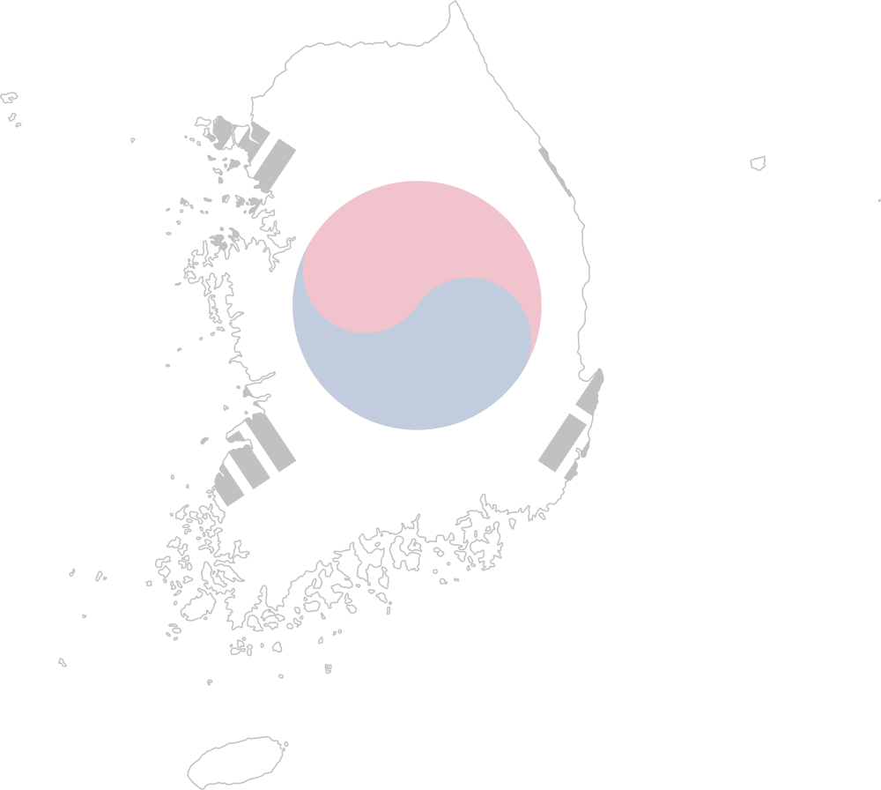





WHICH MARKETS?
Know the regulations that pertain to each market. Different markets pose different requirements.
  Some markets require serialization of all pharmaceuticals.
  Some markets’ serialization requirements only cover particular classifications of products (e.g., prescription medication).
  Some markets require 2D Data Matrix codes with specific information encoded in them in addition to specific human-readable data.
  Some markets require inclusion of a National Reimbursement Number or application of labels for similar purposes.
  Some markets have specific inspection requirements, not just printing and serialization, that may only apply to some products.
© 2015 Systech International. V1.2

Slide 24
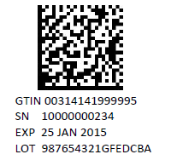


MARKETS: PRODUCTS
The same product may exist in different forms based on the market and its marking and/or serialization requirements. These variations should all be considered different presentations of the same product.
Data Matrix
2 dimensional
Small footprint
Image reader decoded
Widely adopted by pharma
Code 128 Barcode
1 dimensional
Larger footprint
Widely supported in supply chains by laser scanners
Required in China
QR Code
2 dimensional
Smaller footprint
Image reader decoded
China and baby formula
© 2015 Systech International. V1.2

Slide 25
PUTTING TOGETHER THE FULL SET OF REQUIREMENTS
The basic requirements must include:
  Volume and speed of production
  A detailed as-is process
  A detailed to-be process
  “Must-have” functions
  Integration requirements to packaging line (communication, signaling, controller programming, reject handling, additional hardware including Serialization hardware)
  Exception handling
  Security access

Slide 26
REQUIREMENTS: DATA MANAGEMENT IN THE SUPPLY CHAIN
Serialization at the packaging stage is only the beginning, put together the requirements needed for managing the data beyond the packaging line
  Volume of data based on production
  Communication with distributors and logistics operations
  Data visibility and monitoring
  Managing Rework
  Security of the data
© 2015 Systech International. V1.2

Slide 27
DEPLOYMENT MANAGEMENT: DATA COLLECTION
Proper deployment requires solid information:
  Think of a serialization deployment as an ERP/MES installation; it will affect several departments (e.g., QA, Production, Warehousing, IT).
  The configuration depends on the information provided (i.e., Garbage In → Garbage Out).
  The amount of data needed is huge and may involve research and communication with multiple sources.
  Project delays can occur if Product and Market information need to be redefined in the field.
  Getting the correct data in the later stages of the project multiplies the effort and the time lost.
© 2015 Systech International. V1.2

Slide 28
THANK YOU
  www.SystechOne.com

