Slide 1
SUPPLY CHAIN TRACEABILITY ACROSS THE ENTERPRISE
EXPANDING YOUR VIEW
May, 2016

Slide 2


INTRODUCTION
HOST – David DeJean
Vice President – Center of Excellence, Systech
30+ years pharmaceutical packaging and supply chain experience
Industry SME Serialization and Traceability cloud product
joseph.lipari@systechone.com
SYSTECH
Over 30 years of experience
Global Reach – HQ in Princeton, NJ with offices in US, EU, UK and Asia
Experts in Serialization, Traceability, Authentication and Brand Protection

Slide 3
THE PROBLEM
A global economy demands a larger and more complex supply chain.
Brand owners face many challenges and each represents another potential opportunity for error in the supply chain.
Product diversion, introduction of counterfeits, and recalls all impact the safety of the supply chain and the bottom line.
The enterprise and supply chain contain valuable data, ensuring the physical matches the data is vital.
A comprehensive system is required to connect the enterprise and supply chain, identify, and track products from manufacturing to consumer.

Slide 4

WHAT BUSINESS CHALLENGES ARE WE TRYING TO SOLVE?
Patient safety
Build trust
Increased consumer confidence
Comply with global regulations
Avoid quarantine
Confirm market access
Gain visibility
Diversion
Ensure proper handling
Expiration dates
Temperatures
Increase profitability
Simplify recalls
Control returns

Slide 5


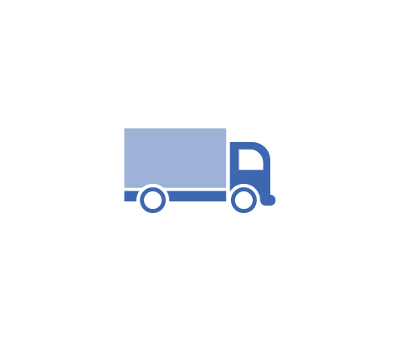





WHAT SYSTEMS ARE WE TRYING TO UNITE?
Inside the 4 Walls of the Manufacturer
Managing the packaging line
Managing contract service providers
ERP
MES
WMS
Out in the Supply Chain
Exchanging data with trade partners
Providing authentication of production content
Synchronizing data storage
Visibility and reporting of supply chain movement
Exception handling support
How to bridge the gap?
Wholesaler
ERP
Warehouse
MES
WMS
Distribution
Dispensary
Warehouse
Warehouse
Distribution
Supplier
CMO / CPO
Supplier
Packaging Lines

Slide 6


WHAT CHALLENGES ARE A RESULT OF DIVERSITY?
VENDOR E
LEVEL 4
VENDOR A
VENDOR B
VENDOR D
LEVEL 3
VENDOR C
LEVEL 2
1
2
3
Distribution
Wholesaler
Dispensary
MFG SITE
Lines

Slide 7





IT ALL STARTS AT THE MANUFACTURER
KEY CONSIDERATIONS
Line speeds impact print quality >> print quality impacts the supply chain.
Does your infrastructure have the flexibility it needs?
SOPs : “business as is” vs. “business to be”.
Anything can happen, how do you support the exception handling?
Do your outsourced resources have the capability to support serialization?
Interface
Offline
Operations
QA Release & Shipping
SERIALS
FACT:
Lines can run
over 500 ppm
FACT:
Lot Sizes
of 2.5M
FACT:
Active Volume
in Billions
Packaging on the Line
Storage, Warehousing & Reworks
Notes:
Real estate : Think about your product. Does it have the space to fit a code? Will that impact the overall presentation of the product?

Slide 8
THE VALUE WEB OF YOUR SUPPLY CHAIN

Slide 9




KNOWING YOUR SUPPLY CHAIN
Supplier
Warehouse
Dispensary
Distribution
Warehouse
CMO / CPO
Distribution
Supplier
Supplier
Hospital
Distribution
Warehouse
CORPORATE PRODUCTION
Warehouse
Traceability means being able to provide full visibility
of a product as it moves through the supply chain.
HQ

Slide 10
HAVE YOU ASSESSED YOUR SUPPLY CHAIN NEEDS?
Who are your trade partners?
How will you manage your serial numbers?
Where will you keep all this data?
What markets do you deliver product to?
How much visibility do you need into your supply chain operations?
Who do you need to exchange data with?
Do your systems speak the same language?

Slide 11


DATA : RICHER, NOT POORER
?
?
Do you have insight into the rich data at every step?
Supplier
Warehouse
Dispensary
Distribution
Is the product valid?
What lot is it from?
When was it produced?
Did it expire?
What was the last event that occurred?
What material (SKU) is it?
Does it have children?
What are the child serial numbers?
Warehouse
CMO / CPO
Distribution
Supplier
Supplier
?
Hospital
Distribution
?
Warehouse
CORPORATE PRODUCTION
Warehouse

Slide 12
A ROBUST DATA MODEL
Do you have the insight into the rich data at every step?
SMS
Item Information
Status | Valid
Primary Identifier | (01)00012345999994(21)000087234674
Barcode | 010001234599999421000087234674
Disposition | in_transit (urn:epcglobal:cbv:disp:in_transit)
Parent | (00)001234500000000878
Last Seen | Pack Site (GLN 012345678901)
Children | 24
Is the product valid?
What lot is it from?
When was it produced?
Did it expire?
What was the last event that occurred?
What material (SKU) is it?
Does it have children?
What are the child serial numbers?
EBR
Batch Information
Batch ID | ABC123
Mfg Date | May 24, 2015
Exp Date | Jan 01, 2019
Material Information
Product | Rx
Description | 100mg Tablets
ID | 776928-02-002
ERP
WMS
Transaction History
2015-05-24 22:27:49 | Commissioning | Pack Line A | active
2015-05-24 22:28:32 | Packing | Pack Line A | in_progress
2016-03-24 08:50:14 | Shipping | Warehouse D | In_transit

Slide 13
BEWARE……
THE IDES OF REWORK

Slide 14
EYE-OPENING DATA
DATA FROM A MAJOR LOGISTICS PROVIDER
  4% of everything shipped, gets returned
  1.8 million units are shipped daily
    15% in totes/cases/pallets
    85% as eaches
  72,000 units arrive back at the facilities for various reasons
  27 hospitals threw away $1.6 million in expired medicine
  Avg. 8 - 10 recalls per week for pharma products
  Avg. 12 - 15 for med device
  Recalls could include entire batches of product

Slide 15
SERIALIZATION ENABLING COST SAVINGS
RECALLS CAN COST MILLIONS
  Little visibility into lot relationship of stock
  How many pieces of product X from lot Y are on the shelves today?
PHARMACIES CAN ONLY VERIFY NDC
  Serialized barcodes provide pharmacies information about product, lot and expiration date to enable more comprehensive quality check
  Unique identifiers and lot data provide ability to query against a global recall database
SERIALIZATION GIVES INSIGHT INTO WHAT LOTS ARE IN STOCK AND ENABLES RAPID RECALL PROCESSING

Slide 16
EXCEPTION HANDLING IS CRITICAL
HAPPY PATH IS EASY, EXCEPTIONS ARE DIFFICULT AND COSTLY.
FINISHED
GOODS
HOW DO WE DEAL WITH…..
WMS
WHEN SHOULD WE…..
STAGING
ERP
WHAT DO WE DO IF……

Slide 17

EXCEPTION HANDLING USE CASES
SUPPLY CHAIN REWORK
  Handling damaged product
  Printing new labels
  Unpack and Repack Aggregation operations
  Making the physical match the electronic
GOODS RECEIPT
  Incoming damaged or wrong product
  Shortage
  Overage
SHIPPING OUTBOUND
  Incorrect destination
  Physical serial numbers do not match electronic records
  Pick/Pack to new parents

Slide 18
COMPLYING WITH GLOBAL REGULATIONS

Slide 19
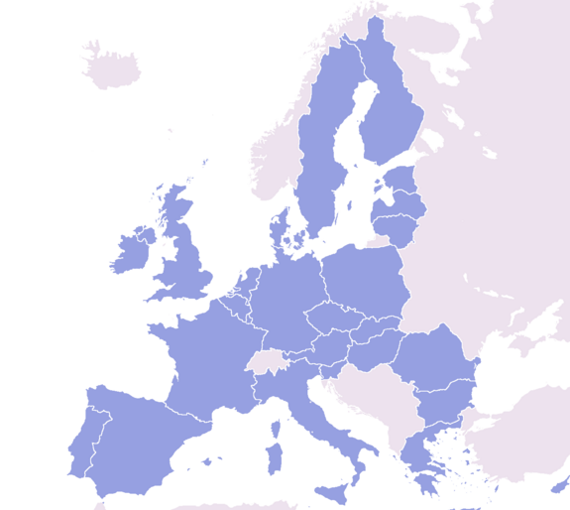

EU SUPPLY CHAIN – A SHORT OVERVIEW
28 member states including Switzerland, Norway, Iceland.
Directive 2011/62/EU
Safety features and unique identification
EU Hub available
2014 - 2015
Delegated Acts into Law
Connections
2015 - 2018
Government reporting
Verification
2019

Slide 20
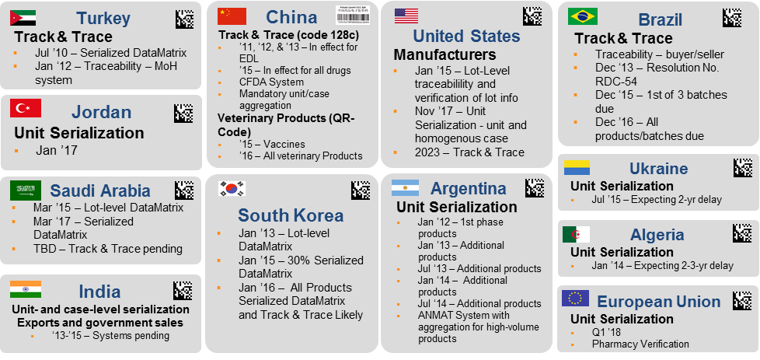
IT’S NOT JUST THE EU … A GLOBAL MOVING TARGET

Slide 21








THE EUROPEAN HUB MODEL
European Hub
Upload Data
Manufacturer
Product Master Data
Packaging Data
Events
National System 1 - n
Wholesaler
Verification
Product #
Batch
Expiry
S/N
Verification upon dispense to Patient
Risk-based verification by Wholesale distributors
Pharmacy
Verification at point of dispense
Pharmaceutical
Manufacturer and
Parallel Distributor
Wholesaler Distributor Pharmacist Patient

Slide 22
SOLUTION APPROACHES

Slide 23
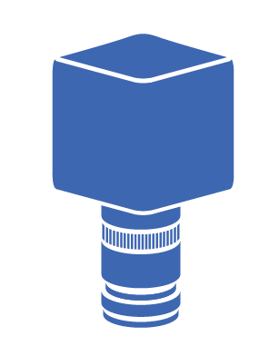
SOLUTION SELECTION CRITERIA
LEVEL 5 | AUTHENTICATION CLOUD
SUPPLY CHAIN
Implement a solution that:
Manages the devices on the line such as printers, inspection, automation
Manage the assets in the site
Sites are not single vendor - Integrates with existing or new systems
Manages the sites from the enterprise level
Provides visibility and control from the enterprise level.
Configuration satisfies change, not software updates.
Manages the data exchange across all levels
LEVEL 4 | ENTERPRISE
LEVEL 3 | SITE
LEVEL 2 | LINE
LEVEL 1 | DEVICE
LEVEL 0 |
PARTNER EQUIPMENT
SYSTECH CERTIFIED

Slide 24
REQUIREMENTS : ENTERPRISE LEVEL AND BEYOND
Serial Number Management
EPCIS Event Repository
Supply Chain Rework
Compliance Gateway
Traceability
3rd Party Data Exchange
Business System Integration

Slide 25
TRACK & TRACE
Supply Chain Traceability

Slide 26
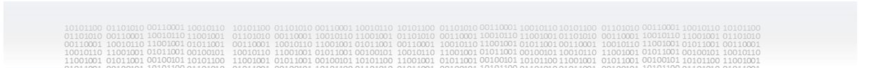



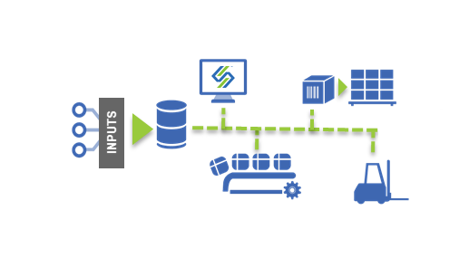

SOLVE CHALLENGES
Serialization
Data exchange
Serial number generation & management
Third parties & Multiple suppliers
EPCIS repository
Traceability
Validate source content at production
EPCIS repository
Visibility and reporting of supply chain movement
Exception handling support
Manufacturing / Packaging
Distributor
Wholesaler
Pharmacy

Slide 27
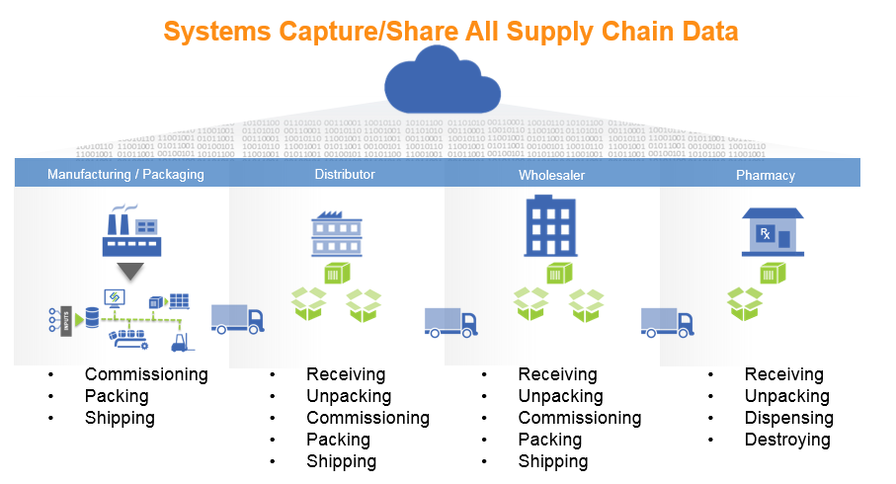
UNITRACE - SOLVING ENTERPRISE SERIALIZATION CHALLENGES
Serial Number Management
EPCIS Event Repository
Supply Chain Rework
Compliance Gateway
Traceability
3rd Party Data Exchange
CMO/CPO Connection Manager

Slide 28








CLOUD BASED SERIAL NUMBER MANAGEMENT
SGTIN/SSCC
(01)(21)GS1
CFDA
RANDOM
LISTS
RANGES

Slide 29
SUPPLY CHAIN REWORK
DC CONSOLE FUNCTIONALITY
  Label Printing
  Packing
  Unpacking
  Picking
  Decommissioning
  Returns
  QA Release
  Receiving
  Shipping
  Sampling
  Lot/Material/Quantity Verification
  Sales Order Integration
EXCEPTION HANDLING
  Handling damaged product
  Printing new labels
  Making the physical match the electronic
INBOUND
  Incoming damaged or wrong product
  Shortage
  Overage
OUTBOUND
  Incorrect destination
  Physical serial numbers do not match electronic records

Slide 30
EVENT REPOSITORY FOR THE SUPPLY CHAIN
Manufacturing / Packaging
Distributor
Wholesaler
Pharmacy
Commissioning
Packing
Shipping
QA Sampling
Receiving
Unpacking
Commissioning
Packing
Shipping
Receiving
Unpacking
Commissioning
Packing
Shipping
Receiving
Unpacking
Destroying
Dispensing

Slide 31
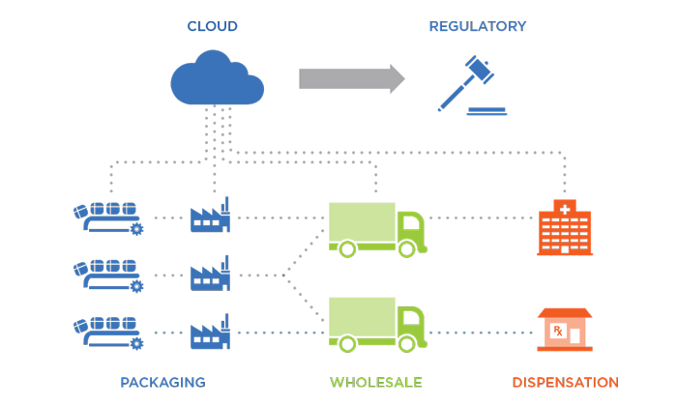
SYSTECH UNITRACE™
Simplified Implementation
Cloud based, infrastructure light technology
Open APIs and Services - customization and integration
  ERP
  MES
  Premise serialization systems
Flexible & Scalable
Adapt to changing regulatory environments
Built from ground up with big data in mind
Deployed since 2006 with CMO/CPO, Pharma, Virtual
Secure & Resilient
Secure access
Built-in firewalls
Flexible authentication scenarios
Private Cloud
Encrypted data storage
Economic
“Pay as you go” model
Low cost integration with supply chain partners
Future proof investment - compliance ready options

Slide 32
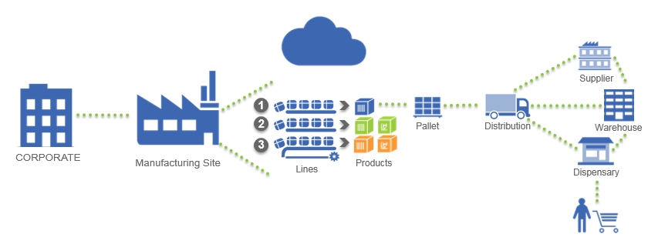
THROUGH THE EYES OF THE BRAND OWNER
Market Persona
Many products
Many sites
Deep supply chain
Internal packaging and contract packaging
Serial Number Management
  Support for ranges, lists, and random numbers
  Multiple setup and import methods giving companies options
Portals
  Giving stakeholders immediate access to data (queries)
Bridging the Gaps
  Connecting all systems with secure data exchange
Compliance Gateway
  Providing the reporting options to ensure brand owners meet regulatory compliance
ECPIS Repository
  Ensuring the data is safe and scalable
Business Requirements and Challenges
Connecting contract packagers
  Outsourcing contract service providers for packaging means levering their expertise and resources - but you are not their only client
Connecting logistics
  Ensuring specific business requirements are supported (aggregation, rework, data exchange)
Managing serial numbers
Market compliance reporting
Connecting EPCIS repository to other business systems

Slide 33
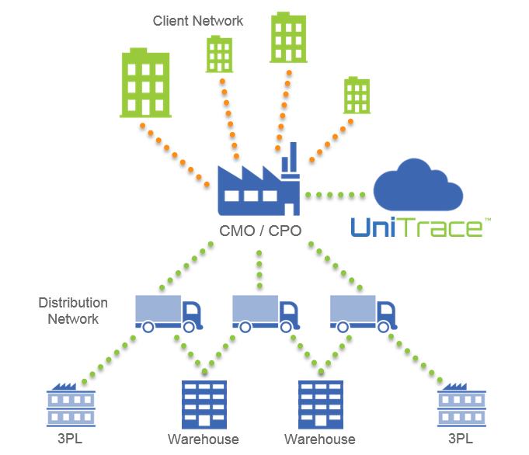
THROUGH THE EYES OF CONTRACT SERVICE PROVIDER
Market Persona
Many customers
Many sites with many lines
Many distribution networks to feed
Customer dedicated lines and multi-purpose lines
Packaging and serialization requirements dictated by customers
Shipping pallets
Simplified Connectivity
  Remove the 1 to 1 relationship between customers and packaging lines
  Manage the data flow from many customers to many packaging lines
Integration Bridge
  Providing the mapping tools to deliver data accurately
  Providing the connection options to transport data securely
  Provide support for inbound and outbound data streams
Warehouse Rework
  Be ready for exception handling in the warehouse
  Full supply chain rework capabilities
  Integrate with ERP systems
Business Requirements and Challenges
Connecting their customers
  Many customers = many systems
Connecting their packaging sites and lines
Data exchange with their customers
  Serialization adds increased importance on data exchange
  Not only customers, but customer’s distribution networks
Meeting client serialization requirements
  Ensuring specific business requirements are supported
  Aggregation/no agg on varying packaging formats
Rework capabilities

Slide 34
Security
Feeling Safe in the Cloud
Rev 2.0 - Oct 2015

Slide 35
LEVELS OF CLOUD SECURITY
Physical/Internal Security
Application Security
eAttack and Malware Protection
Firewalls
Host and Virtual OS IAM
Backups and Disaster Recovery

Slide 36
SHARED RESPONSIBILITY MODEL
HTTPS (443)
AWS is responsible to protect the services, hardware, software, and facilities of the cloud.
Systech is responsible to protect the applications running in the cloud.
AWS are audited by 3rd party companies and provide full visibility in reporting : aws.amazon.com/compliance
AS2 (5080)
APPLICATION
sFTP (5022)
SOAP/REST (443)
API
AWS Region Infrastructure
(
IaaS
)
EC
2
S
3
Load
RDS
Balancer

Slide 37




SUMMARY
ACHIEVE COMPLIANCE
Numerous evolving regional regulations
KNOW AND MEET MARKET REGULATIONS
BE READY FOR EXCEPTIONS
Happy path is great, but ensure readiness for the “what ifs”
IDENTIFY THE EXCEPTIONS AND STRENGTHEN YOUR SUPPLY CHAIN
SYSTEMS UNITE
Multiple vendors and interfaces
CHOOSE A FLEXIBLE SOLUTION
SECURE BRAND
Stabilize trust throughout the supply chain
ENSURE YOUR BRAND IS PROTECTED
HARNESS THE DATA, IT’S OUT THERE
Gather data and provide value
HUGE VALUE FROM RICH DATA

Slide 38
THANK YOU
www.SystechOne.com
US +1 609-395-8400
EU +011 32 2 467 0330
marketing@systechone.com

